Slide 1
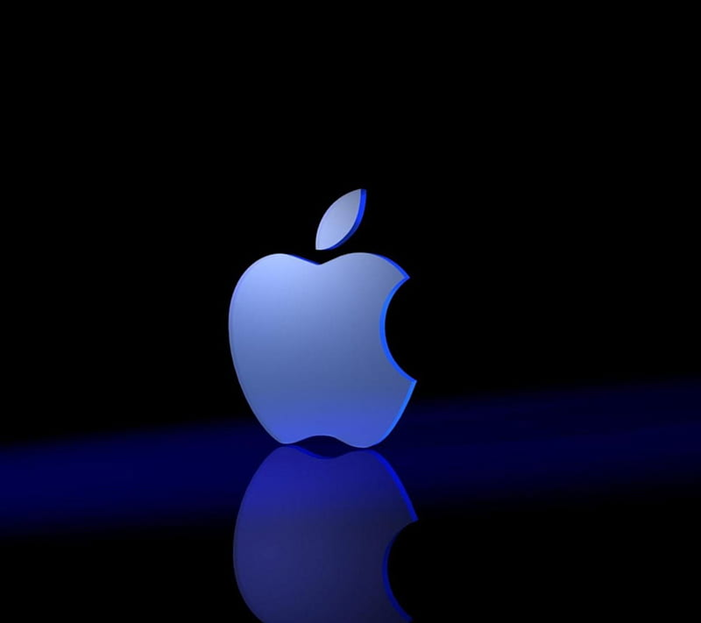
A Data Driven Exploration of Apple's iPhone impact in India
Team
T Pavithra
K Nithyavarshini
M Nithyasri
S Narmatha

Slide 2
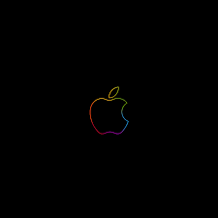
INTRODUCTION :
The world has changed as a consequence of the increasing use of smartphones, which have improved communication, connected people, and revolutionized many different businesses. With its main product, the iPhone, capturing markets around the world, Apple Inc. has emerged as a prominent player among the top smartphone makers. India, one of the economies with the greatest economic growth, has seen a tremendous increase in smartphone usage, making it an interesting market to study the effects of Apple's iPhone.

Slide 3

the market percentage of iPhone in India
Apple has rapidly expanded its manufacturing operations in India, making it one of its largest iPhone export hubs.
iPhone successful in India
The company is projected to account for 7% of all smartphone sales in the country from July to December, up from 5% in the first half of 2023, according to data from market researcher Counterpoint shared exclusively with Reuters.

Slide 4
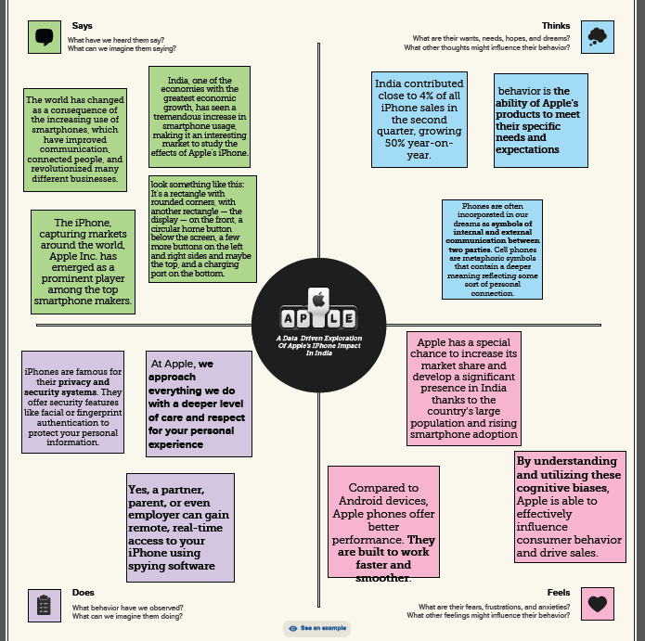
Problem Definition & Design Thiniking
Empathy Map

Slide 5
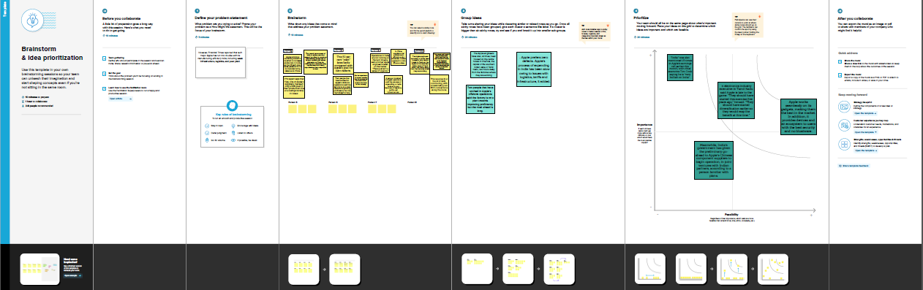
Ideation & Brainstorming Map

Slide 6
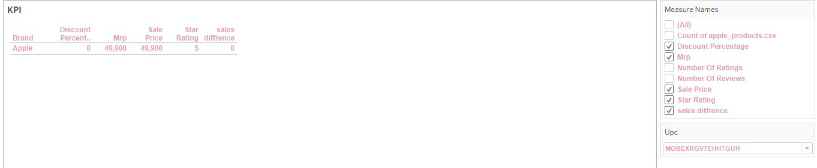
Result

Slide 7
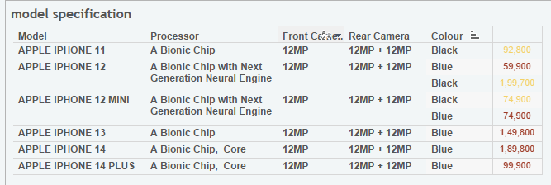

Slide 8
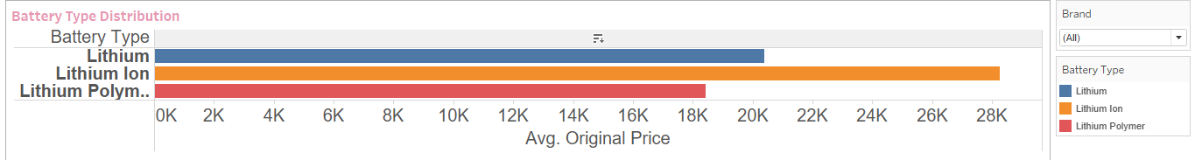

Slide 9
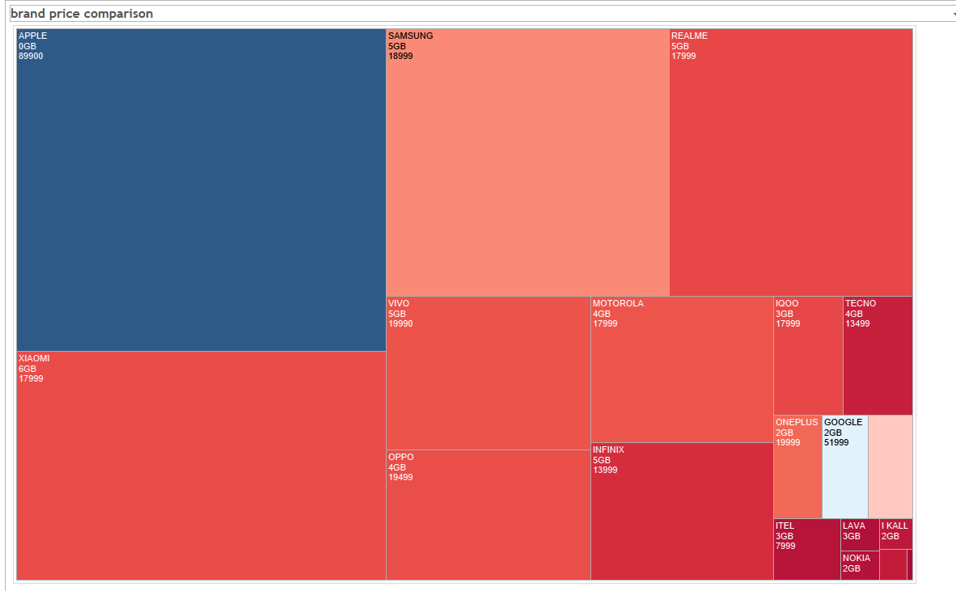

Slide 10
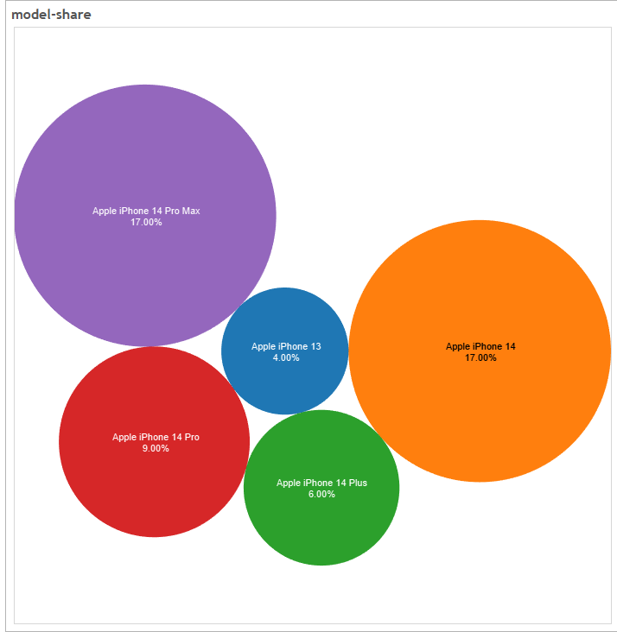

Slide 11
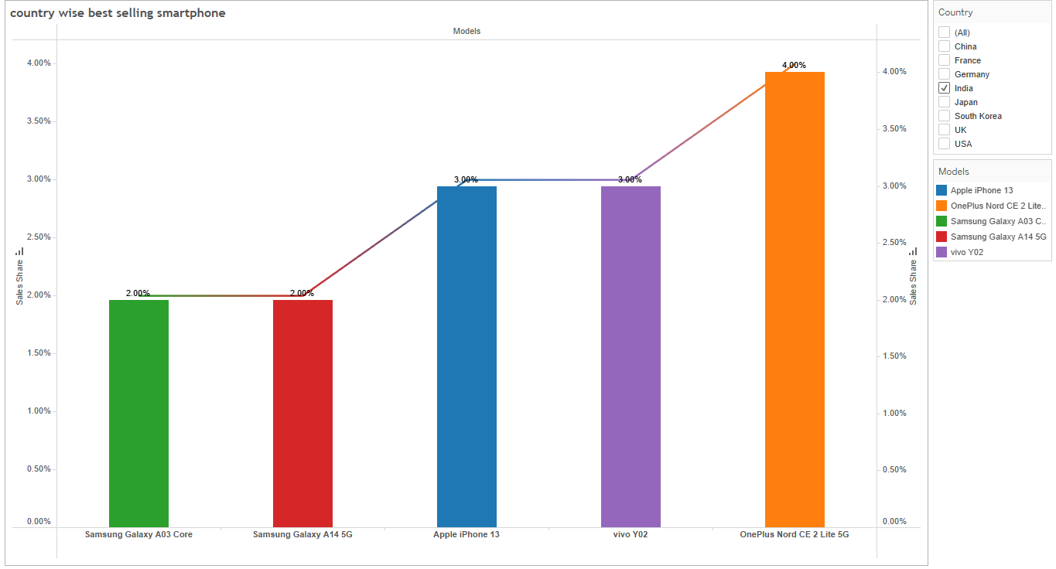

Slide 12
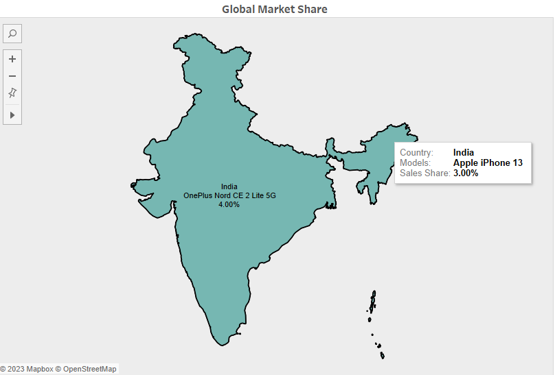

Slide 13
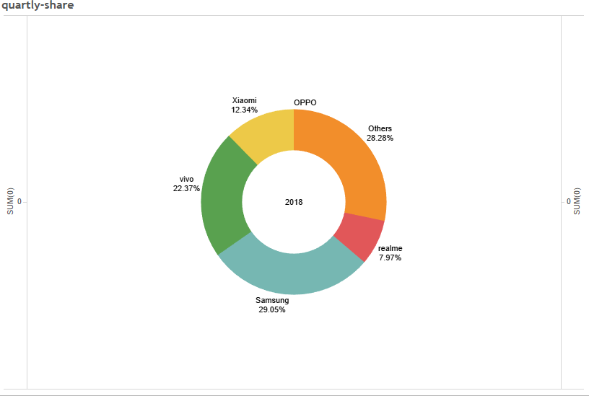

Slide 14
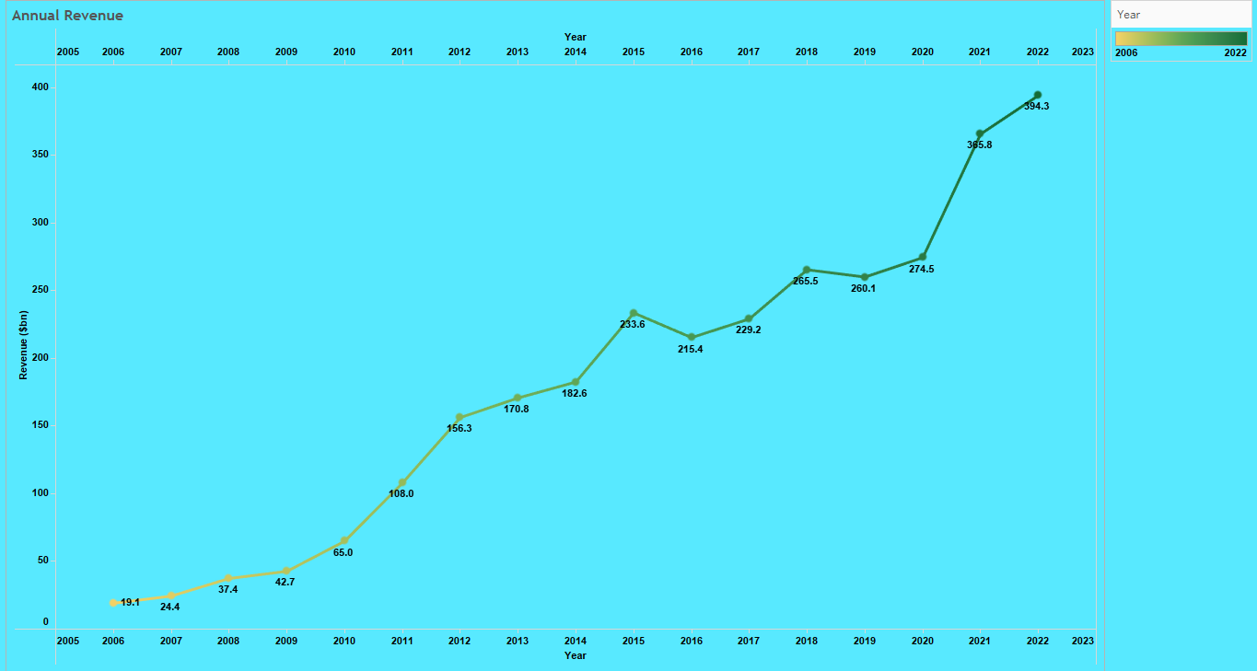

Slide 15
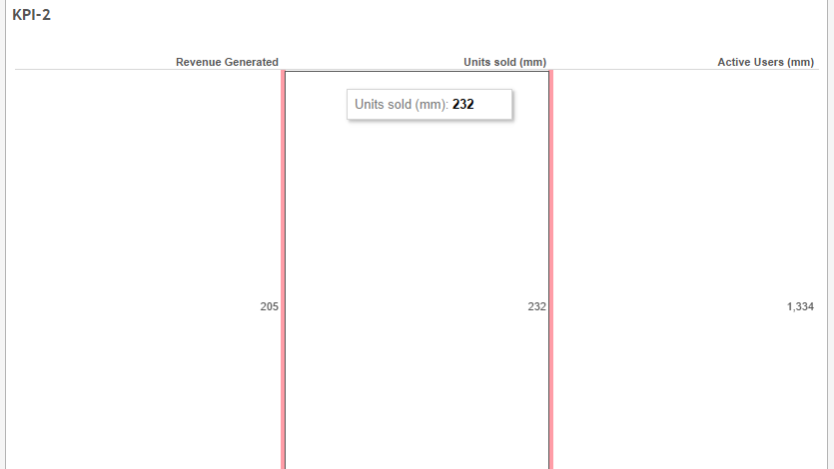

Slide 16
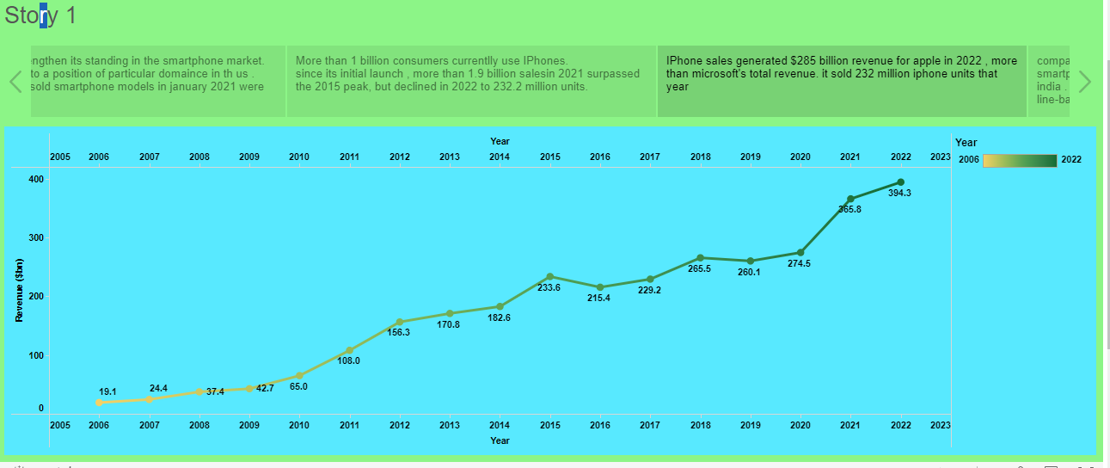

Slide 17
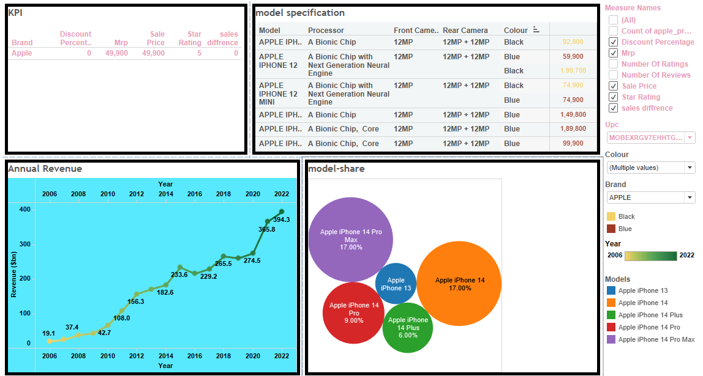

Slide 18


Slide 19
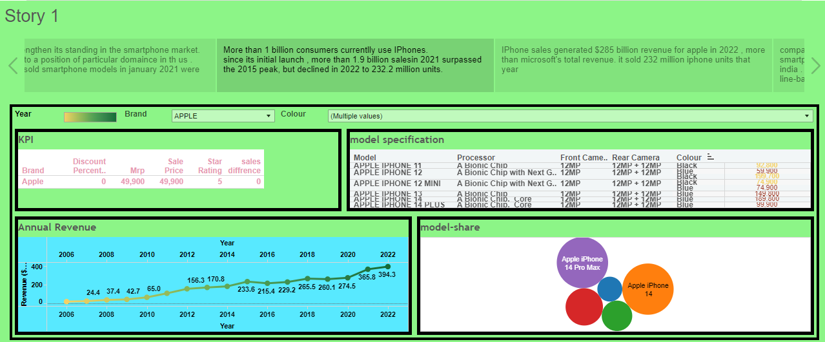

Slide 20
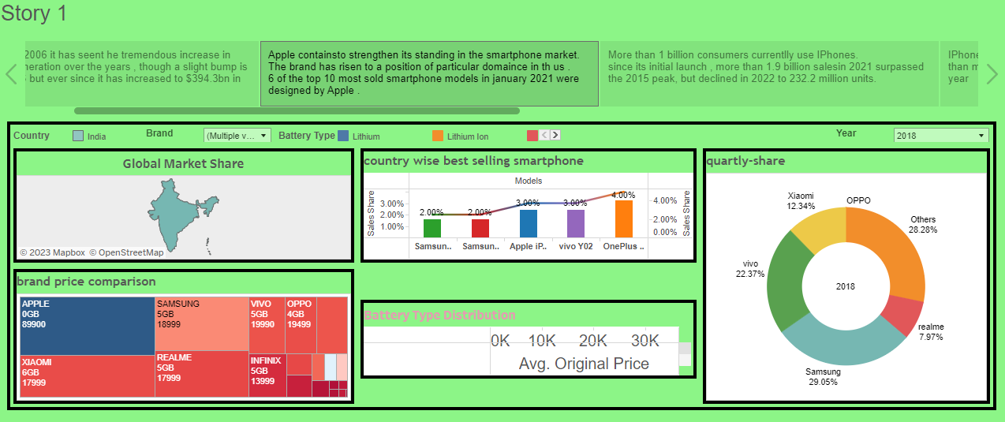

Slide 21
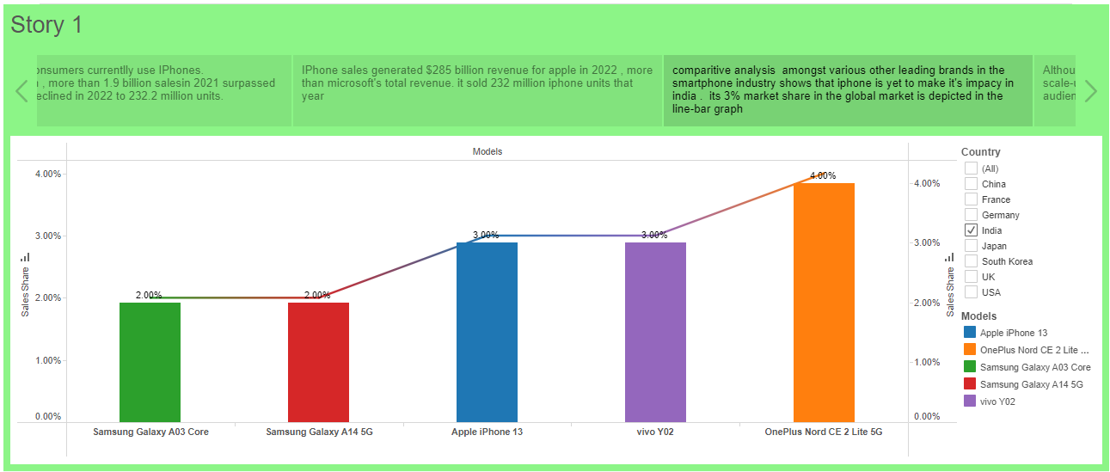

Slide 22
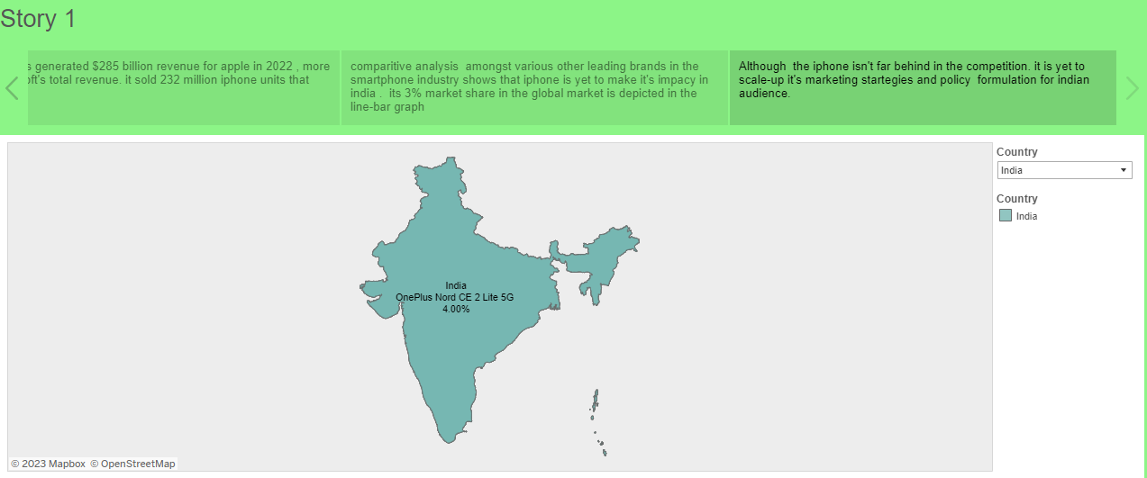

Slide 23
Advantages of the iPhone:
1. User-Friendly Interface: The iPhone has an intuitive user interface that makes it easy to navigate. The touch screen interface is easy to use, and the iPhone’s smooth operating system is simple to learn and use.
2. High-Quality Display: The iPhone’s Retina display is one of the best in the market. With a density of over 300ppi, pictures and videos appear clear and crisp. This high-quality display is perfect for streaming TV shows, movies, and graphic-intensive games.
3. Advanced Camera: iPhone devices have some of the best cameras in the market. They have been known to produce stunning images and videos of the highest quality. They also come with image stabilization features that help reduce blur and take better pictures in low light.
4. Apps Ecosystem: The App Store is unparalleled in terms of access and ease of use. With millions of apps to choose from, users have access to a plethora of tools, games, and services that cater to their needs.
5. Seamless Integration with other Apple devices: The iPhone has a seamless integration with other Apple devices such as MacBook, iPad, and Apple Watch. It allows users to access and transfer data across multiple devices.

Slide 24
Disadvantages of the iPhone:
1. Cost: The iPhone is one of the most expensive smartphones on the market. High-end models can cost over $1000, which makes it a luxury item for many people.
2. Non-Removable Battery: The iPhone’s batteries are non-removable, which means that users cannot replace them. This can be a disadvantage for people who rely heavily on their phones and have to replace them regularly.
3. Limited Customization: One of the disadvantages of the iPhone is that it has limited customization options. Unlike Android devices, users cannot customize their phone’s interface, which can be a disadvantage for some people.
4. No Expandable Storage: Another disadvantage of the iPhone is that it has no expandable storage options. Users have to purchase iPhones with larger storage capacities, which can be costly.
5. Frailty: The iPhone is known to be fragile and prone to breaking if dropped. Many users have reported cracking or shattering their screens after accidentally dropping their devices.
In conclusion, the iPhone has been a game-changer in the technological world. It has revolutionized the way people communicate and access information. However, its advantages and disadvantages must be weighed carefully by potential buyers. Ultimately, the choice of whether to purchase an iPhone depends on the user’s preference, needs, and budget.

Slide 25
Applications :
App Store
Main article: App Store (iOS/iPadOS)
The App Store is a digital distribution platform which allows users to browse and download apps developed with Apple's iOS Software Development Kit. The App Store opened on July 10, 2008 with the release of IPhone OS 2, launching with 500 applications available. The number of apps peaked at around 2.2 million in 2017, but declined slightly over the next few years as Apple began a process to remove old apps or 32-bit apps that do not function as intended or that don't follow current app guidelines.^{[3]} As of 2020, the store features around 1.8 million apps. On September 19, 2019, Apple Arcade, a gaming subscription service that provides unlimited access to a catalogue of games for a monthly fee, was released through a dedicated tab on the App Store.^{[4]}

Slide 26
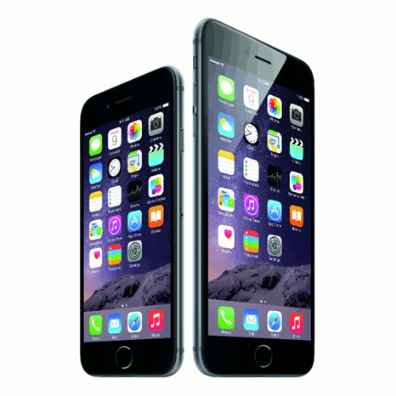
Conclusion
In summary, it is apparent that the iPhone was,and still, a remarkable invention of technological advancement. The iPhone provided a new way of mobile phone communication and usability. Its revolutionary technology has led to the variety of smartphones that are in use today. The iPhone success story has not been without unethical business practices by Apple Inc., security concerns and social problems. However, these controversies cannot erase the fact that the iPhone stands out as major technological innovation of the 21st Century.

Slide 27
FUTURE SCOPE:
The factors that are going to affect iOS application development in the coming years are as follows:
Factor #1 : Globalization
App studios are going to face increased competition, globally.
Factor #2 : Cross-Device Development
Apps for television, cars, smartphones, and others are on the boom.
Factor #3: Developer Tools
The prevalence of easily application programming interfaces and software developer kits will make it easier to stitch top-end app functionality together.
Factor #4: Supply & Demand
The startups and enterprises app demands are not going to be an abate, however, studios will be pressed by both the international and independent markets with minimizes profit margins.
Factor #5:Monetization
The viability of paid app downloads will be mitigated by different business models, inclusive of in-app purchases and subscription services.

